Slide 1
Part - III
Cloud Security Mechanisms:
Encryption,
Hashing,
Digital Signature,
Public Key Infrastructure (PKI),
Identity and Access Management (IAM),
Single Sign-On (SSO),
Hardened Server Images.

Slide 2
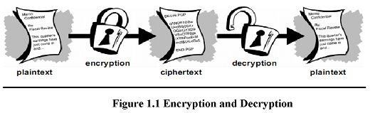
Encryption
Data by default is coded in a readable format known as plaintext . When transmitted over a network , plaintext is vulnerable to unauthorized and potentially malicious access.
The encryption mechanism is a digital coding system dedicated to preserving the confidentiality and integrity of data. It is used for encoding plaintext data into a protected and unreadable format.

Slide 3
Types of Encryption:
1) Symmetric
2) Asymmetric
1) Symmetric Encryption :-
Symmetric encryption uses the same key for both encryption and decryption both of which are performed by authorized parties that use the one shared key.
It is also known as secret key cryptography, messages that are encrypted with a specific key can be decrypted by only that same key.
Note that symmetrical encryption does not have the characteristics of non-repudiation.

Slide 4
2) Asymmetric Encryption
Asymmetric encryption relies on the use of two different keys namely a private key and a public key.
With asymmetric encryption ( which is also referred to as public key cryptography ) , the private key is known only to its owner while the public key is commonly available.
A document that was encrypted with a private key can only be correctly decrypted with the corresponding public key.

Slide 5
Hashing
The hashing mechanism is used when a one way , non reversible form of data protection is required . Once hashing has been applied to a message, it is locked and no key is provided for the message to be unlocked. A common application fro this is the storage of passwords.
Hashing technology can be used to derive a hashing code or message digest from a message , which is often of a fixed length and smaller than the original message.
The message sender can then utilize the hashing mechanism to attach the message digest to the message. The recipient applies the same hash function to the message to verify that the produced message digest is identical to the one that accompanied the message.
Any alteration to the original data results in an entirely different message digest and clearly indicates that tampering has occurred.

Slide 6
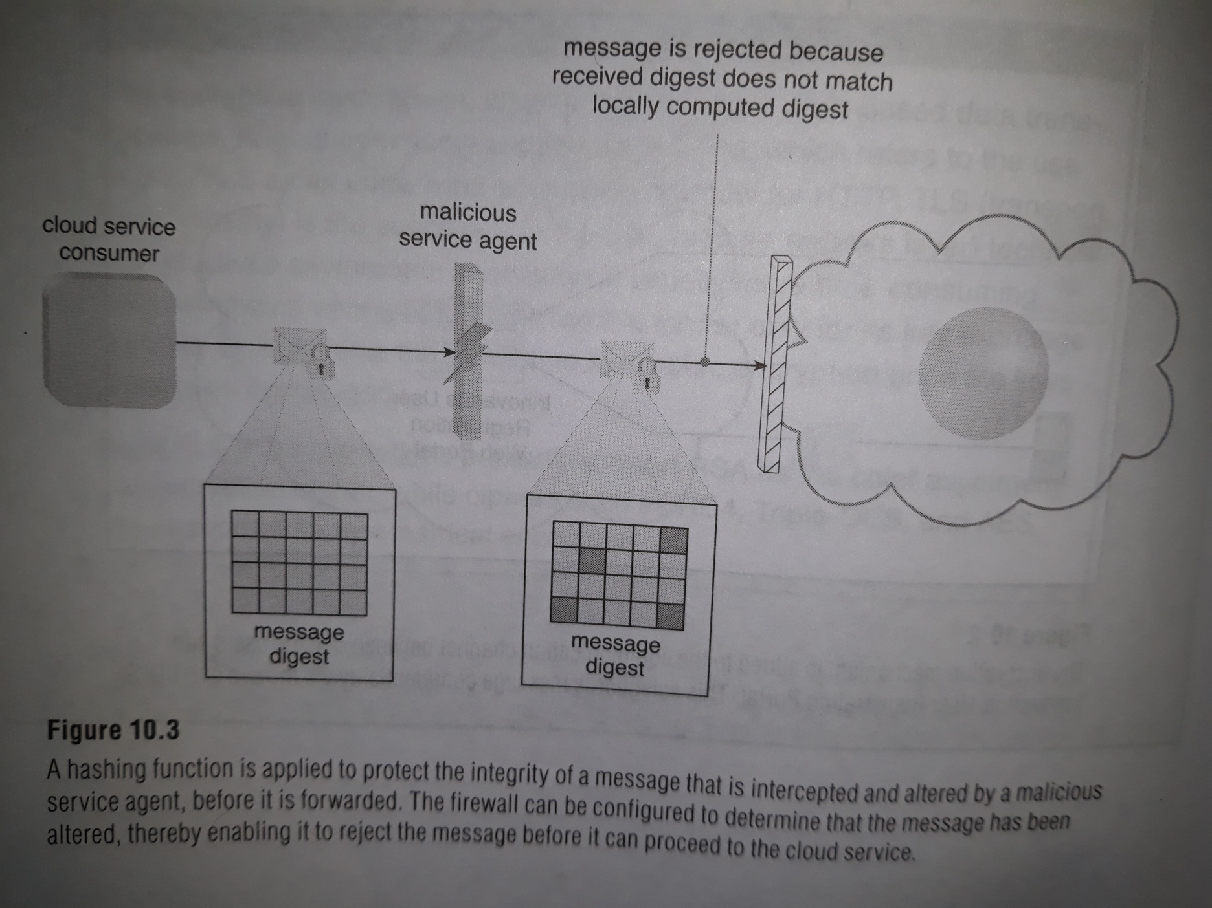

Slide 7
Digital Signature
The digital signature mechanism is a means of providing data authenticity and integrity through authentication and non-repudiation. A message is assigned a digital signature prior to transmission , which is then rendered invalid if the message experiences any subsequent , unauthorized modifications.
A digital signature provides evidence that the message received is the same as the one created by its rightful sender.

Slide 8
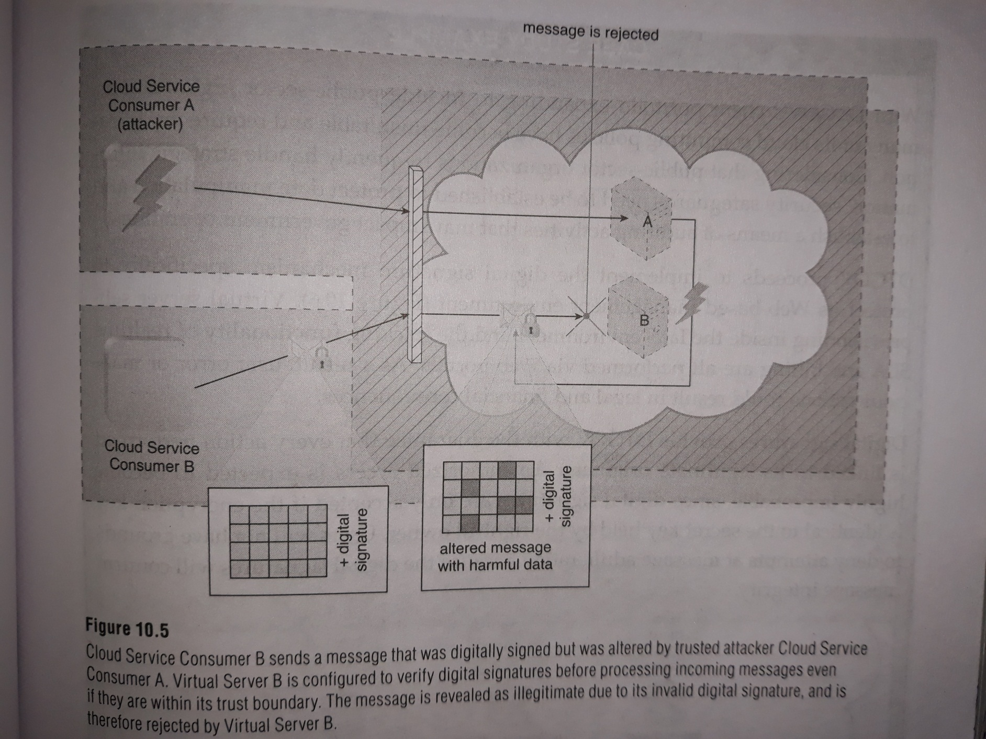

Slide 9
Public Key Infrastructure (PKI)
A common approach for managing the issuance of asymmetric keys is based on the public key infrastructure (PKI) mechanism , which exists as a system of protocols , data formats , rules and practices that enable large
scale systems to securely use public keys with their corresponding key owners (known as public key identification) while enabling the verification of key validity.

Slide 10
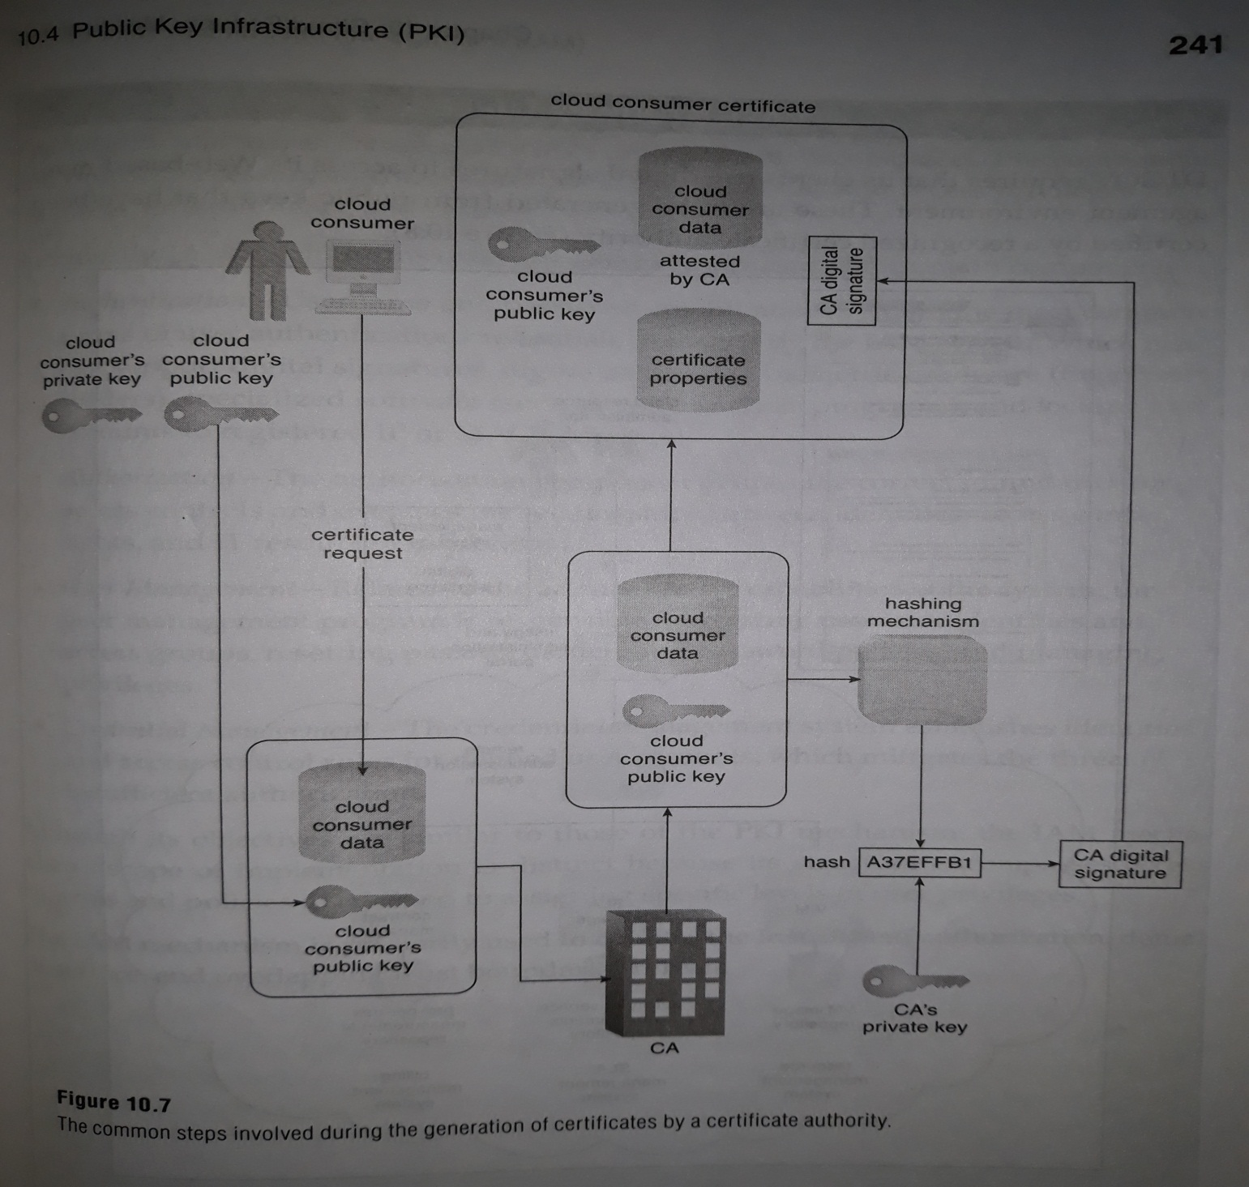

Slide 11


Trusted Attacker
shares IT resources in the same cloud environment as the cloud consumer and attempts to exploit legitimate credentials to target cloud providers and the cloud tenants with whom they share IT resources.
Trusted attackers (also known as malicious tenants) can use cloud-based IT resources for a wide range of exploitations, including the hacking of weak authentication processes, the breaking of encryption, the spamming of e-mail accounts, or to launch common attacks, such as denial of service campaigns.

Slide 12

Malicious Insider
Malicious insiders are human threat agents acting on behalf of or in relation to the cloud provider.
Figure The notation used for an attack originating from a workstation. The human symbol is optional.

Slide 13
Cloud Security Threats
This section introduces several common threats and vulnerabilities in cloud-based environments and describes the roles of the aforementioned threat agents.

Slide 14

Traffic Eavesdropping
It occurs when data being transferred to or within a cloud (usually from the cloud consumer to the cloud provider) is passively intercepted by a malicious service agent for illegitimate information gathering purposes .
The aim of this attack is to directly compromise the confidentiality of the data and, possibly, the confidentiality of the relationship between the cloud consumer and cloud provider.

Slide 15
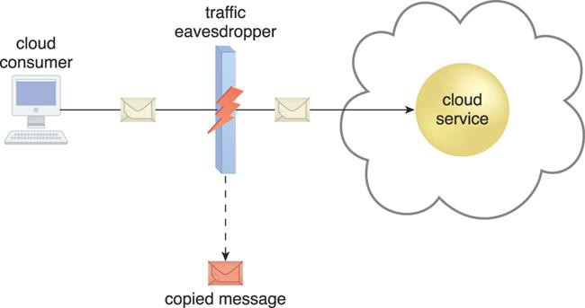
Traffic Eavesdropping
Figure . An externally positioned malicious service agent carries out a traffic eavesdropping attack
by intercepting a message sent by the cloud service consumer to the cloud service. The service agent makes an unauthorized copy of the message before it is sent along its original path to the cloud service.

Slide 16
Malicious Intermediary
Arises when messages are intercepted and altered by a malicious service agent, thereby potentially compromising the message’s confidentiality and/or integrity.
It may also insert harmful data into the message before forwarding it to its destination.

Slide 17
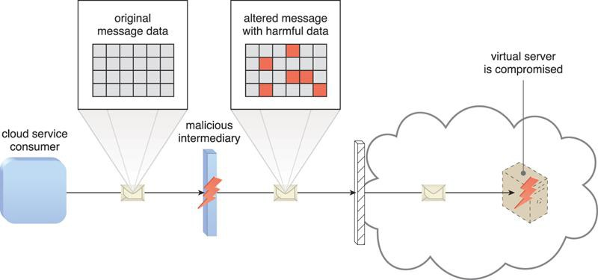
Malicious Intermediary
Figure. The malicious service agent intercepts and modifies a message sent by a cloud service consumer to a cloud service (not shown) being hosted on a virtual server. Because harmful data is packaged into the message, the virtual server is compromised.

Slide 18
Denial of Service
The objective of the denial of service (DoS) attack is to overload IT resources to the point where they cannot function properly.
This form of attack is commonly launched in one of the following ways:
The workload on cloud services is artificially increased with imitation messages or repeated communication requests.
The network is overloaded with traffic to reduce its responsiveness and cripple its performance.
Multiple cloud service requests are sent, each of which is designed to consume excessive memory and processing resources.

Slide 19
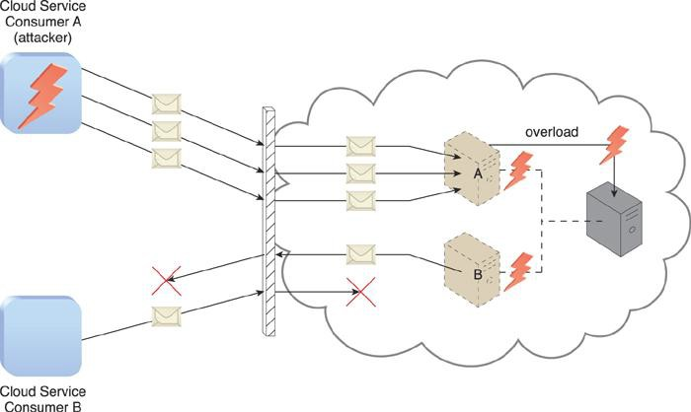
Denial of Service
Figure. Cloud Service Consumer A sends multiple messages to a cloud service (not shown) hosted
on Virtual Server A. This overloads the capacity of the underlying physical server, which causes outages with Virtual Servers A and B. As a result, legitimate cloud service consumers, such as Cloud Service Consumer B, become unable to communicate with any cloud services hosted on Virtual Servers A and B.

